Slide 1




Data-Limited Fisheries Toolkit
Evaluating management strategies for data-limited fish species
Custom performance analysis
Lecture 3c, May 2017
Tom Carruthers & Adrian Hordyk .
Nicolas Gutierrez

Slide 2
Agenda
Interpreting the data stored in the MSE object
Designing performance metrics
User plots

Slide 3
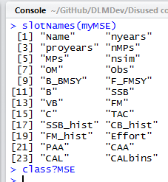
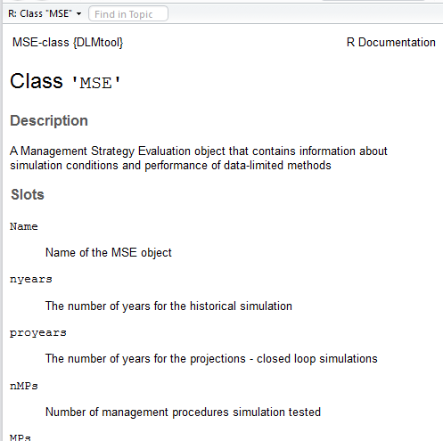
The MSE object
Similarly to Stock, Fleet, Obs and Imp objects, the MSE object has number of slots:

Slide 4
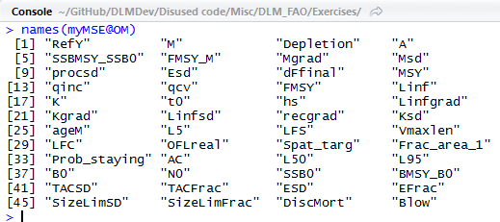
The ‘OM’ slot
The OM slot of an MSE object (e.g. myMSE@OM) contains all the simulated parameter values for the operating model (e.g. natural mortality rate, depletion, MSY, FMSY etc).

Slide 5
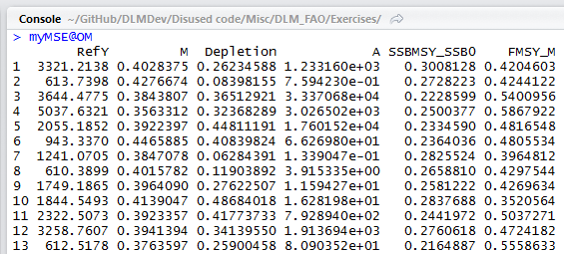
The ‘OM’ slot
The OM slot is a table with n parameter columns and a row for each simulation:

Slide 6
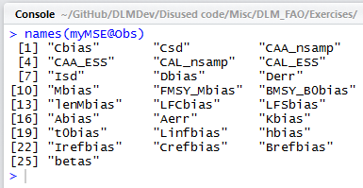
The ‘Obs’ slot
The Obs slot of an MSE object (e.g. myMSE@Obs) is very similar to the OM slot and is a table containing all of the simulated observation model values (e.g. bias in catches, imprecision in catches etc)

Slide 7
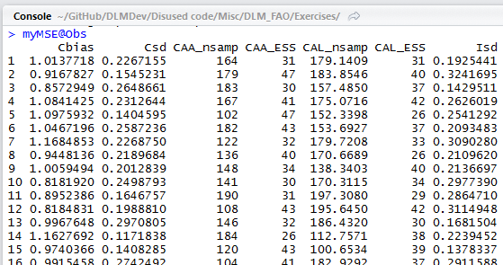
The ‘Obs’ slot
Just like the OM slot, the Obs slot is a table with n parameter columns and a row for each simulation:

Slide 8
Other handy MSE slots
@SSB Spawning biomass
@B_BMSY Spawning biomass relative to BMSY
@F_FMSY The rate of fishing relative to FMSY
@TAC The TAC recommendation
@C The catches that were taken
All of these slots are arrays of data for each simulation, each MP and every projected year. E.g:
myMSE@SSB[1, 2, 3]
Is the spawning biomass for simulation 1, MP 2 and year 3.
Knowing how to access data in MSE objects means you can create your own performance metrics…

Slide 9



Mean SSB by MP:
Probability SSB is over 5% BMSY:
Mean catch relative to MSY

Slide 10
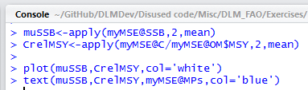
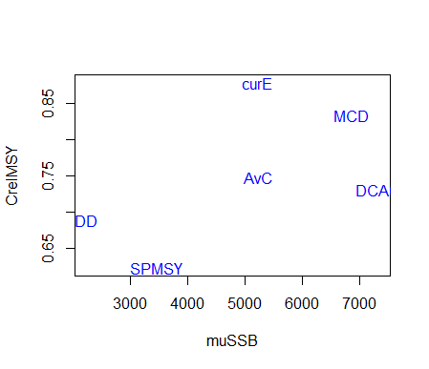
A custom trade-off plot

Slide 11
Getting help with MSE objects
Cheat sheets for objects: /Help/Cheat sheets/
User manual: /Help/DLMtool 4 User Guide.pdf
R package help: class?MSE
Online help: https://dlmtool.github.io/DLMtool/index.html

Slide 12
Think about
Performance metrics in your system
Types of output data you would like to have access to

